Slide 1
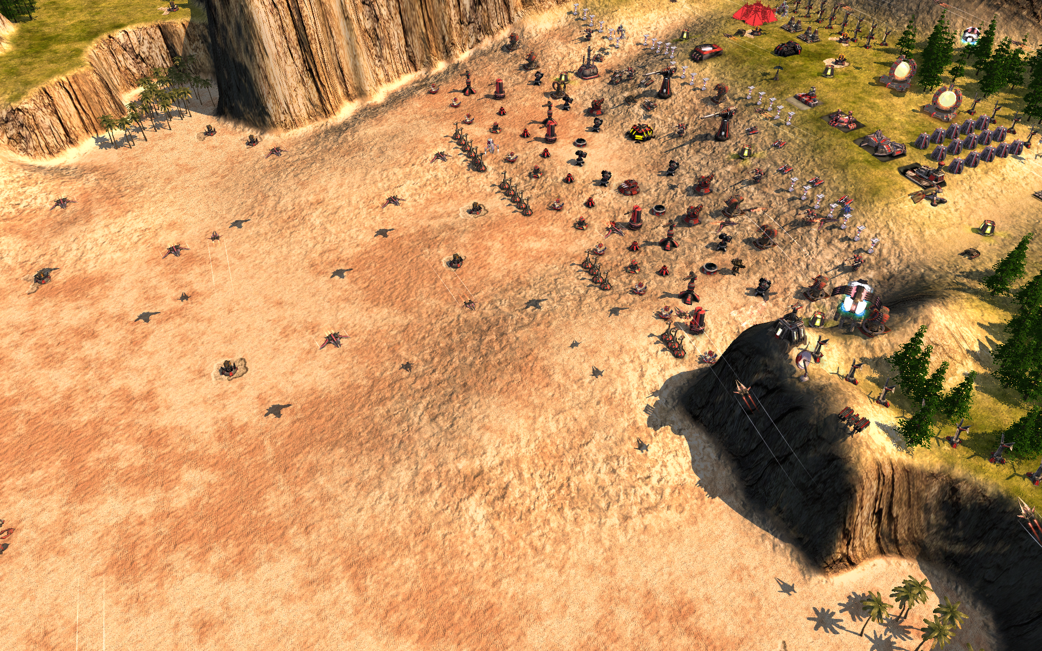
Notes:
So how would you attack this base?

Slide 2
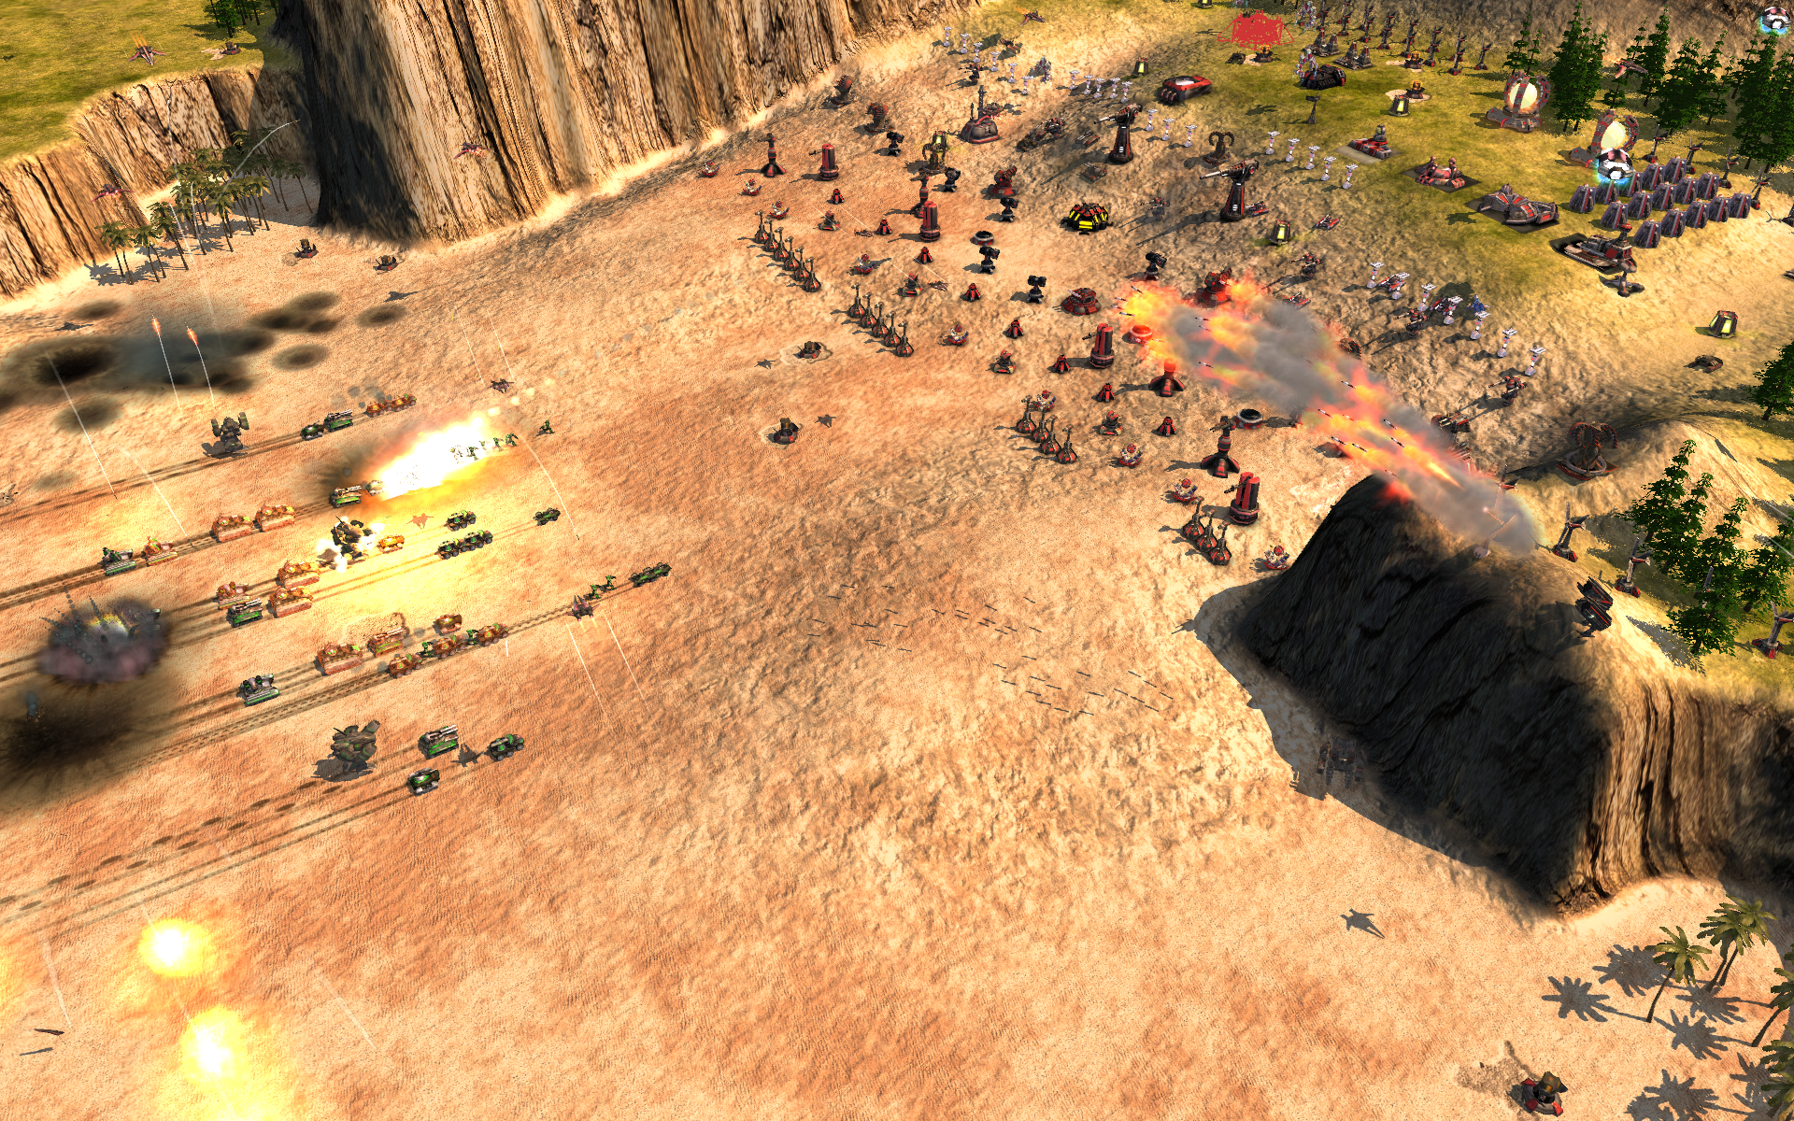
Notes:
With tank army?

Slide 3
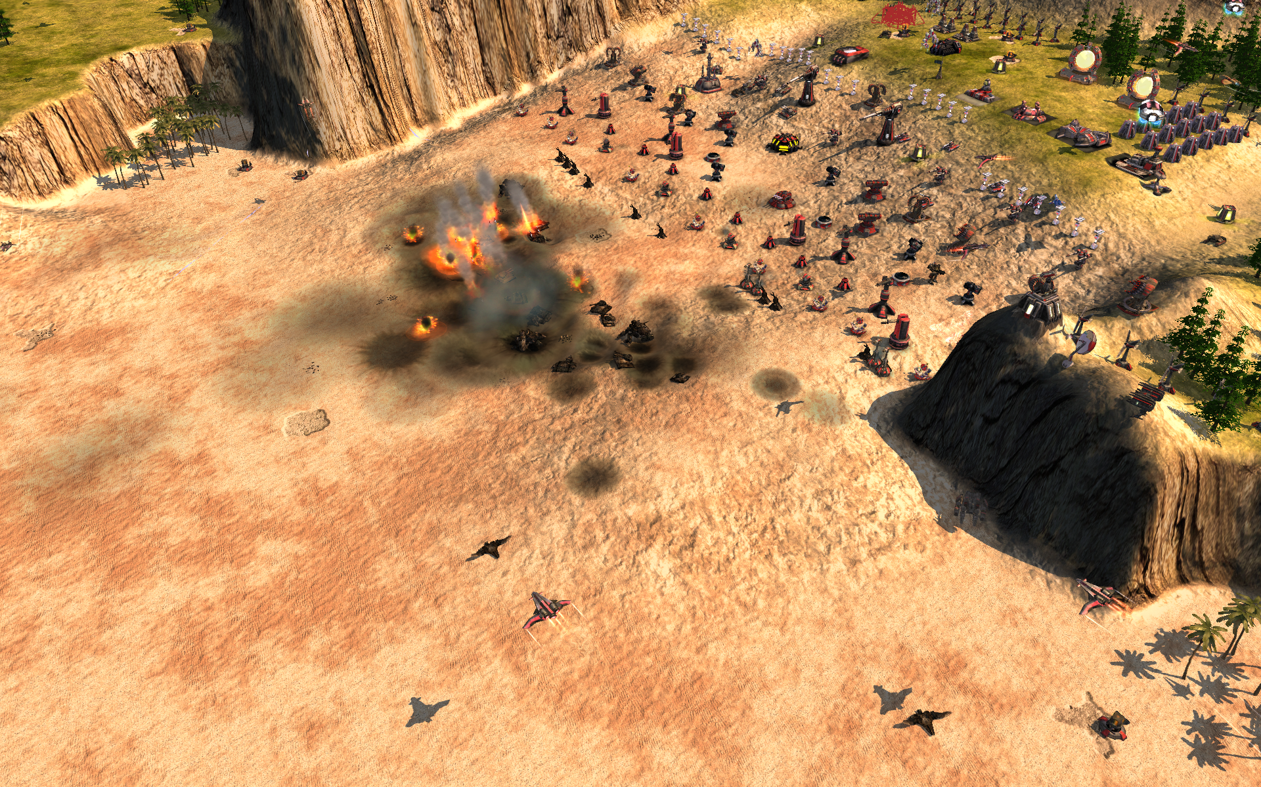
Notes:
Didn’t work..

Slide 4
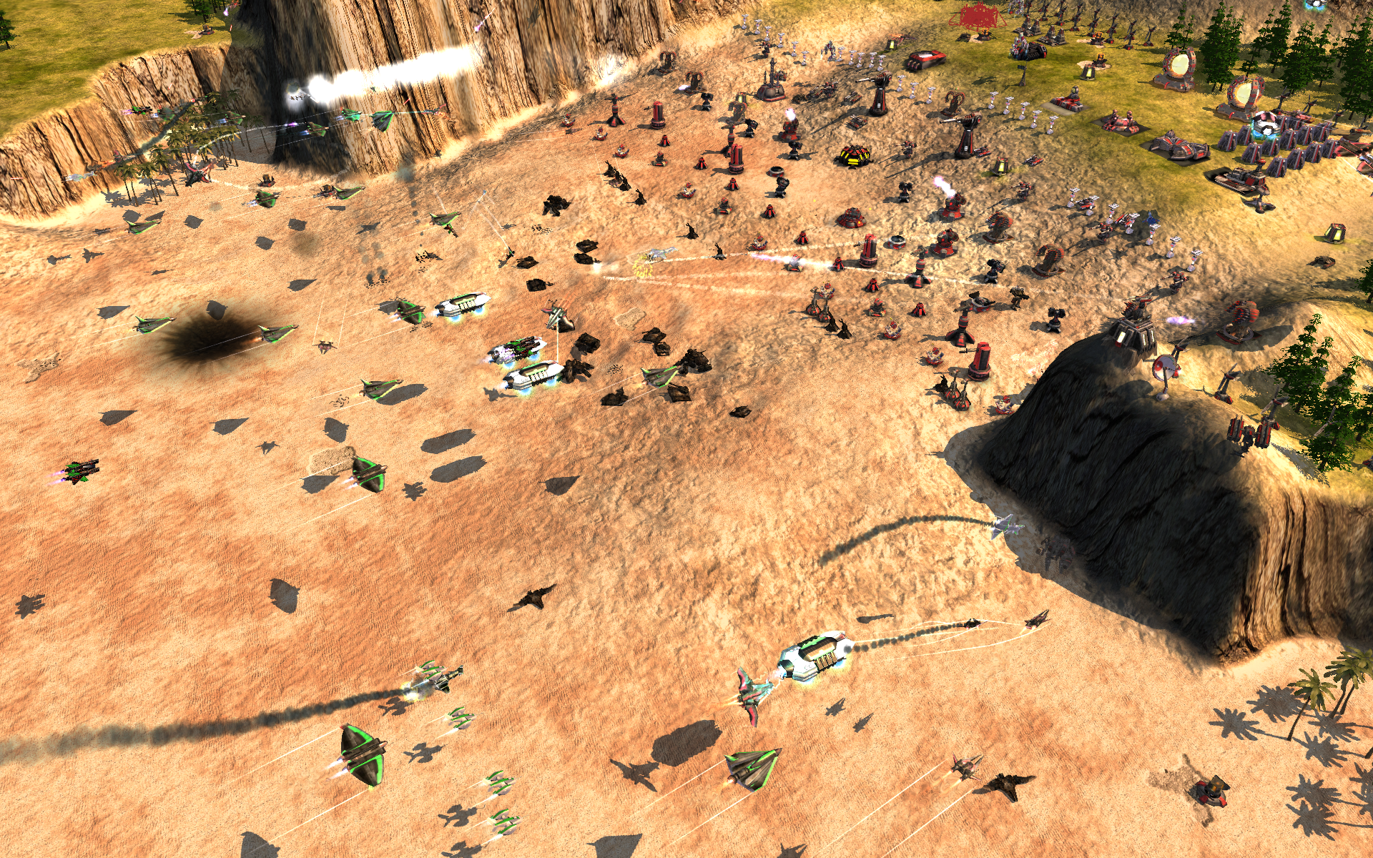
Notes:
So maybe massive air strike?

Slide 5
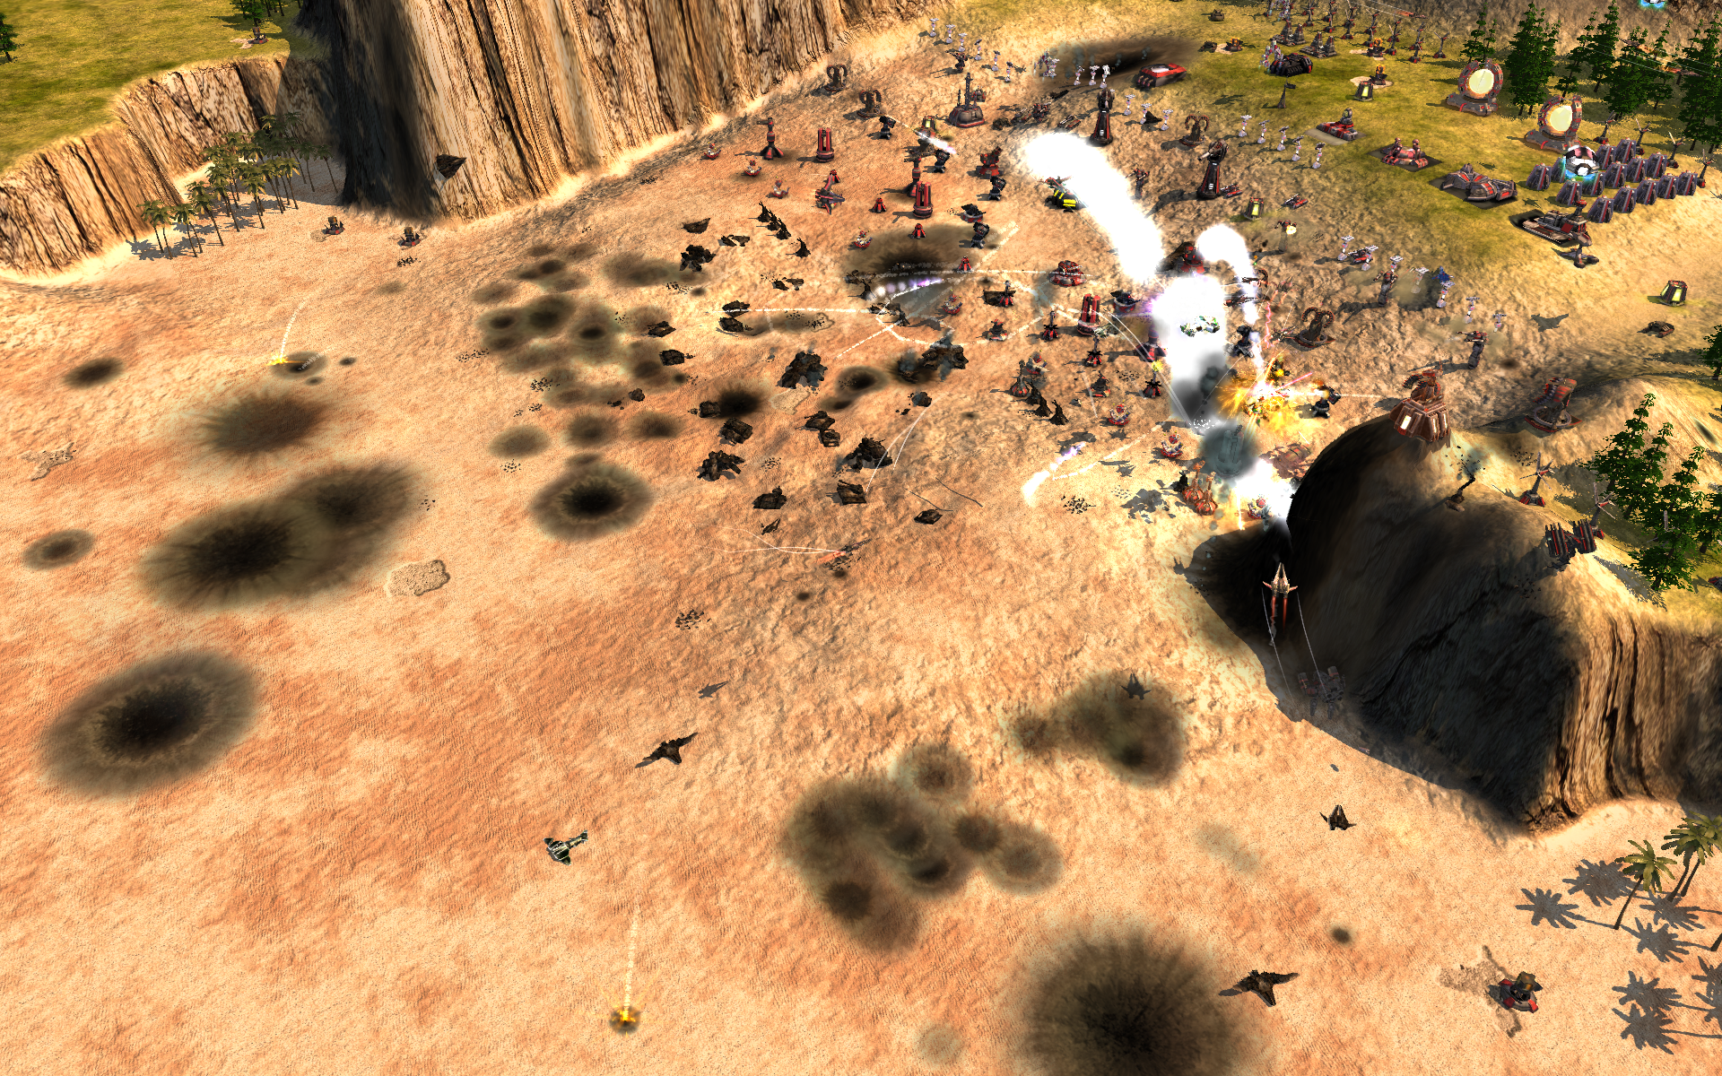
Notes:
No chance

Slide 6
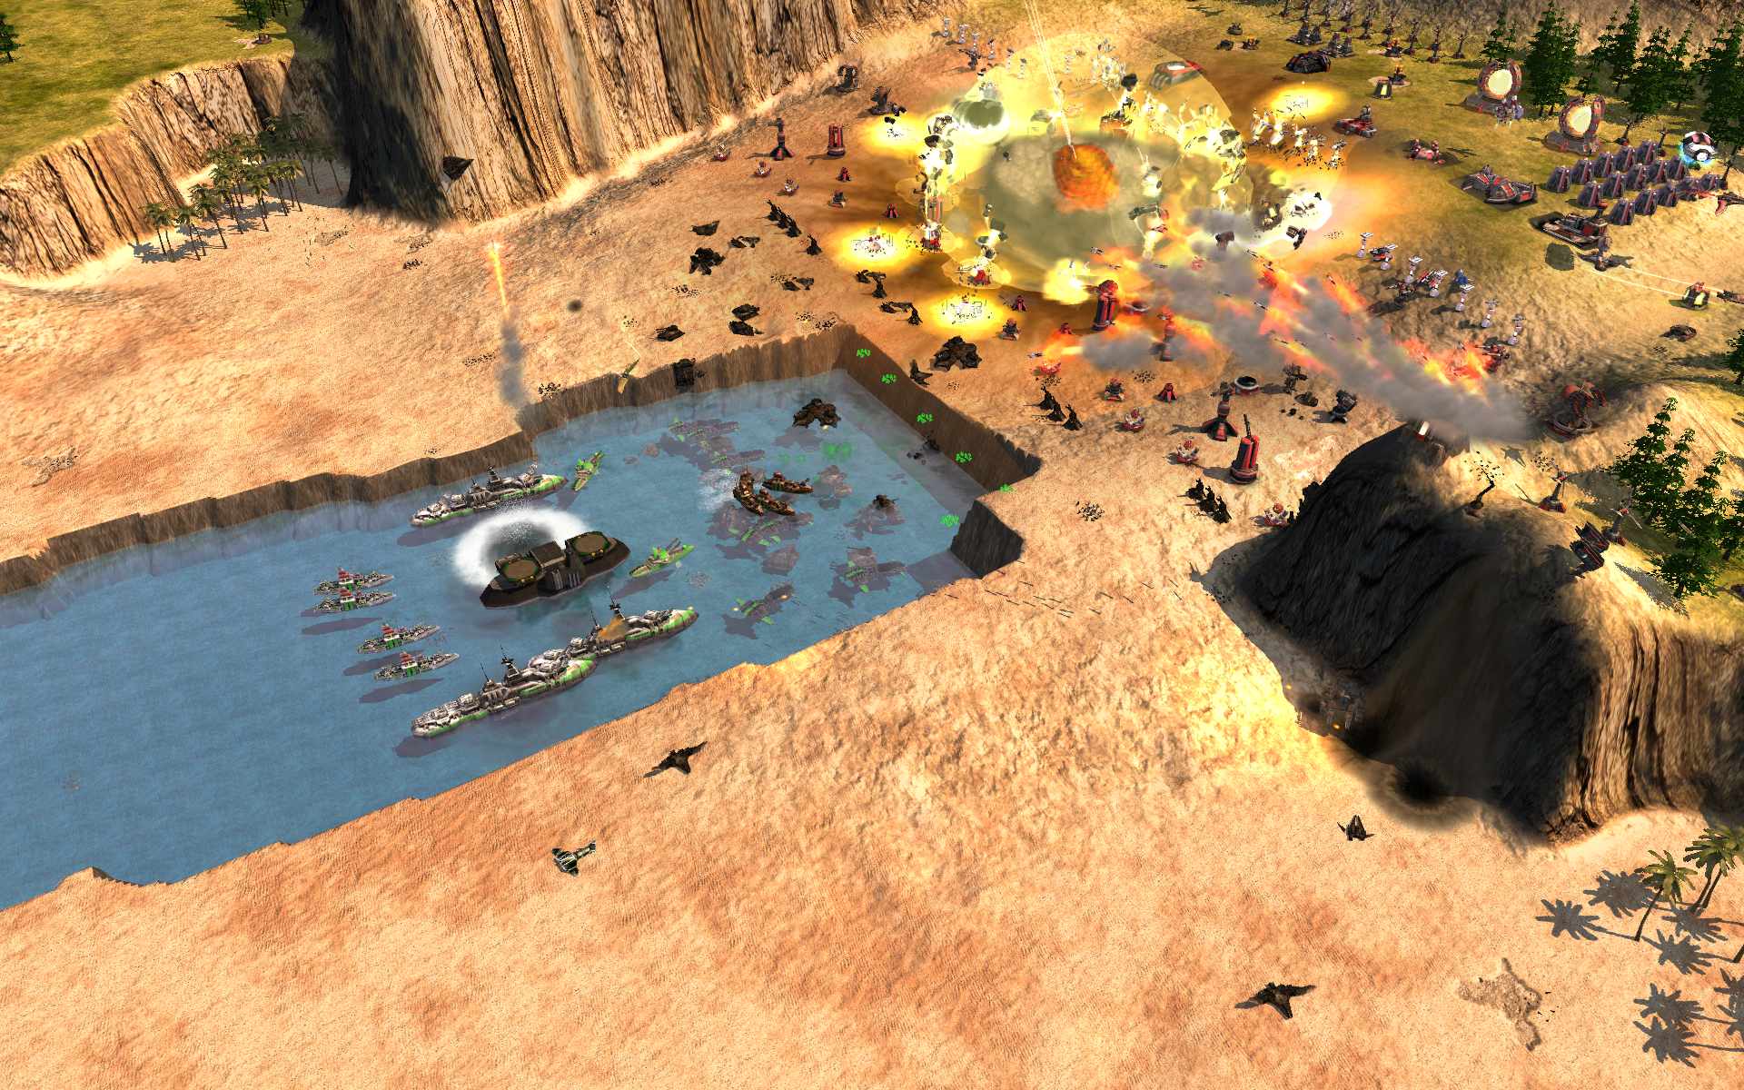
Notes:
The answer of course is, the submarines! (Well of course the real answer is that you just walk around right .. well..uhm)

Slide 7
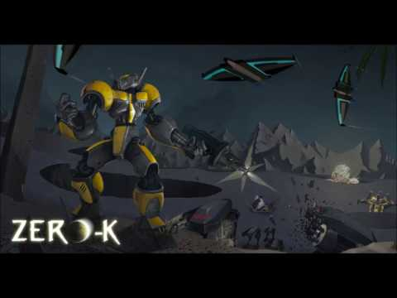
Notes:
So this, is Zero-K

Slide 8
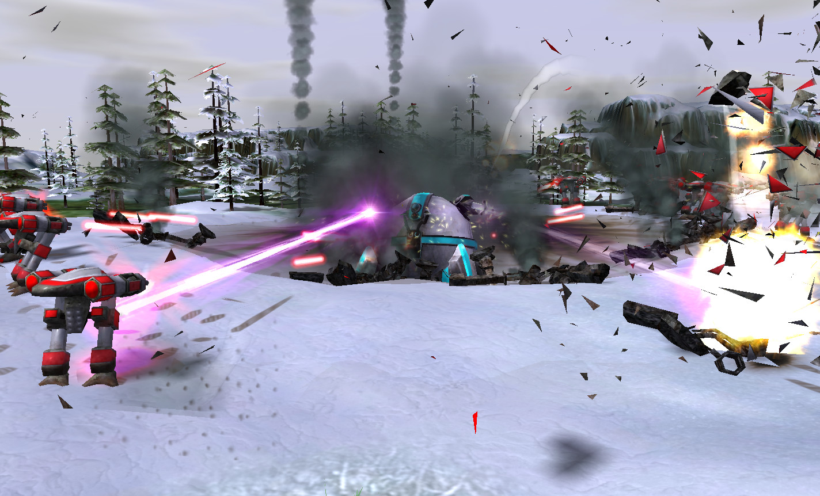
Notes:
When large, heavy units land, they leave big craters in the ground.
‹#›

Slide 9
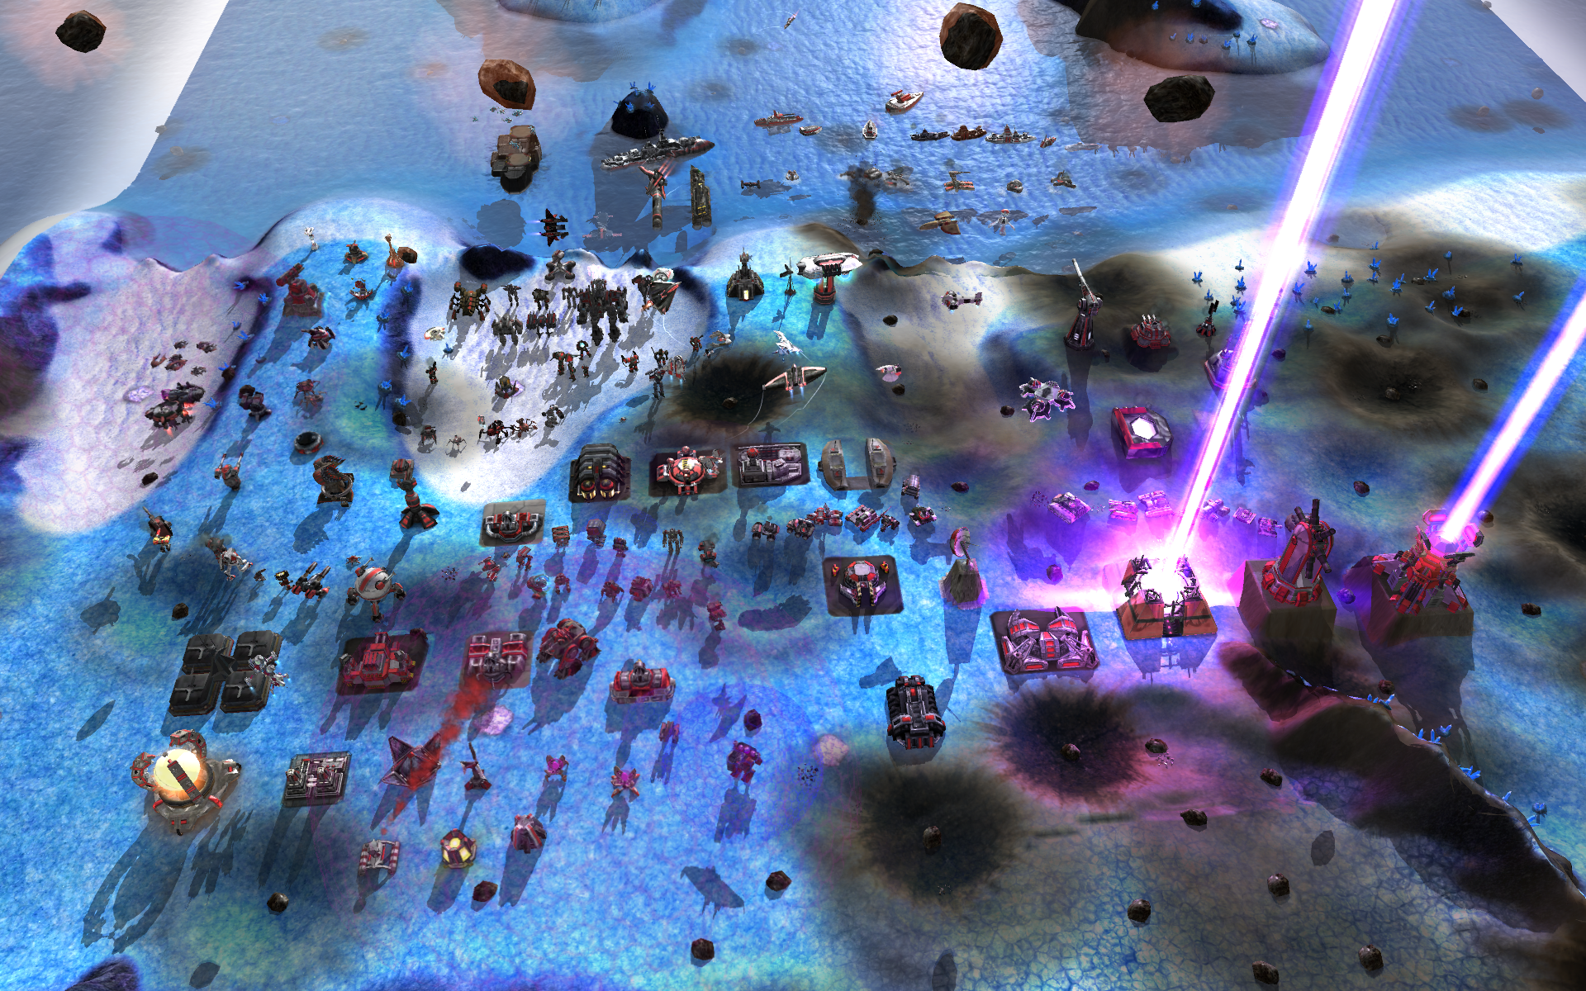
Notes:
We have 171 unit and many of those have a unique mechanic. We’ll focus on terraformers today.

Slide 10
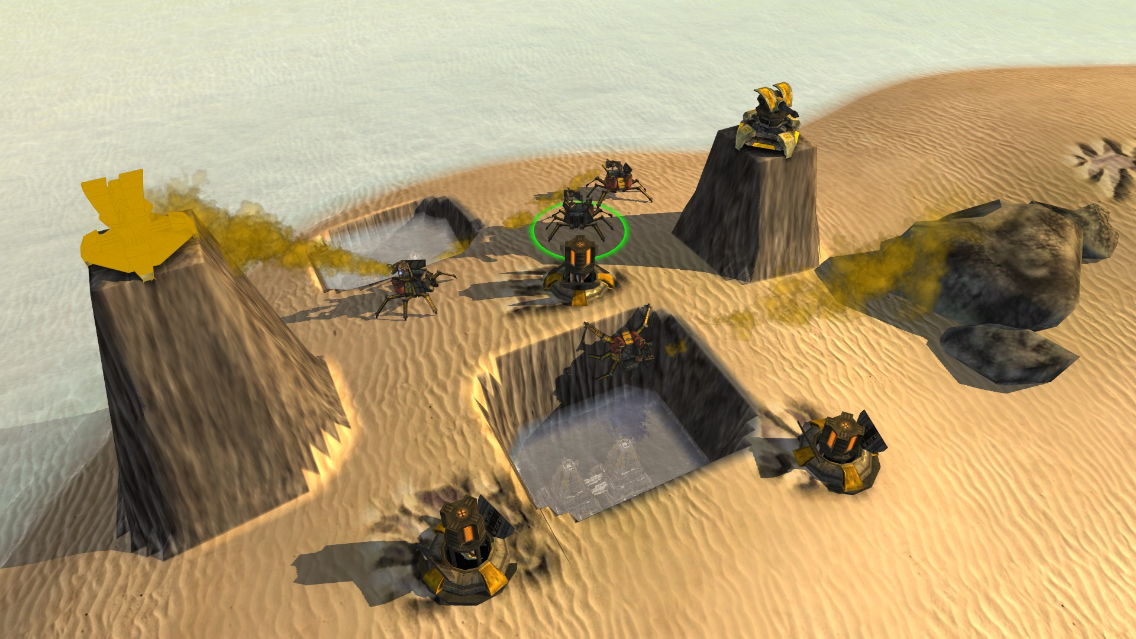
Notes:
Our players can modify the map in-game, during a match. We call it terraforming. This player buried a fusion reactor in a trench, flooded it, and protected it with turrets on towers.
‹#›

Slide 11
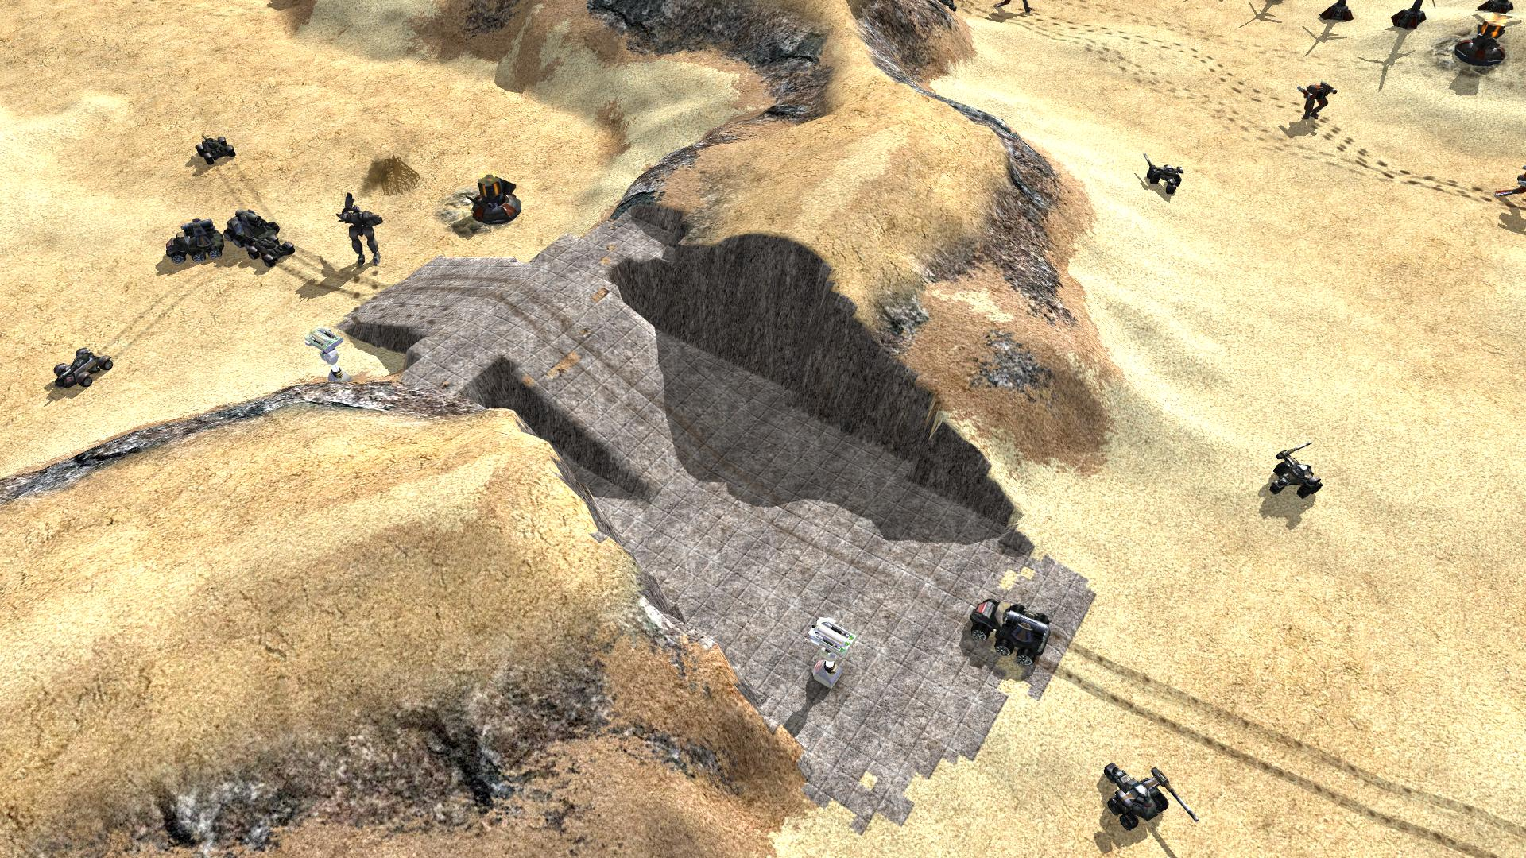
Notes:
This is from a game in august - why climb a hill when you can drive through?

Slide 12
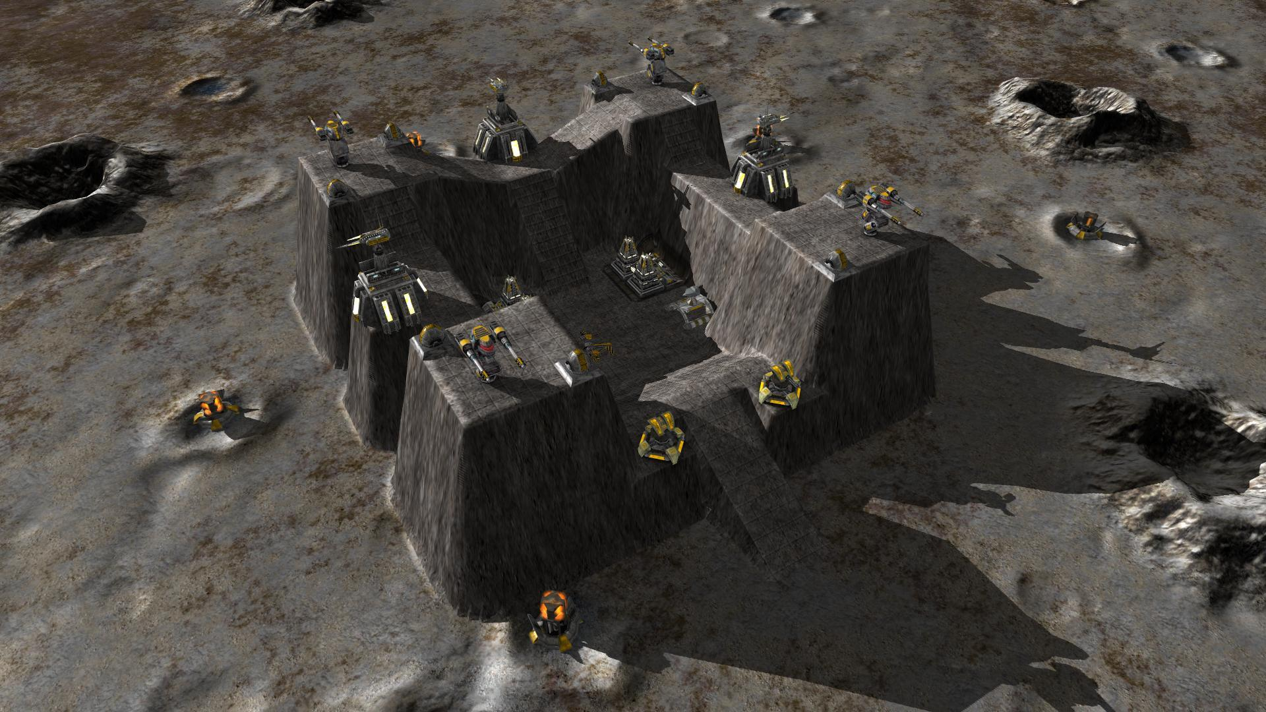
Notes:
This is a moon fort. It’s unknown whether space nazis live there.

Slide 13
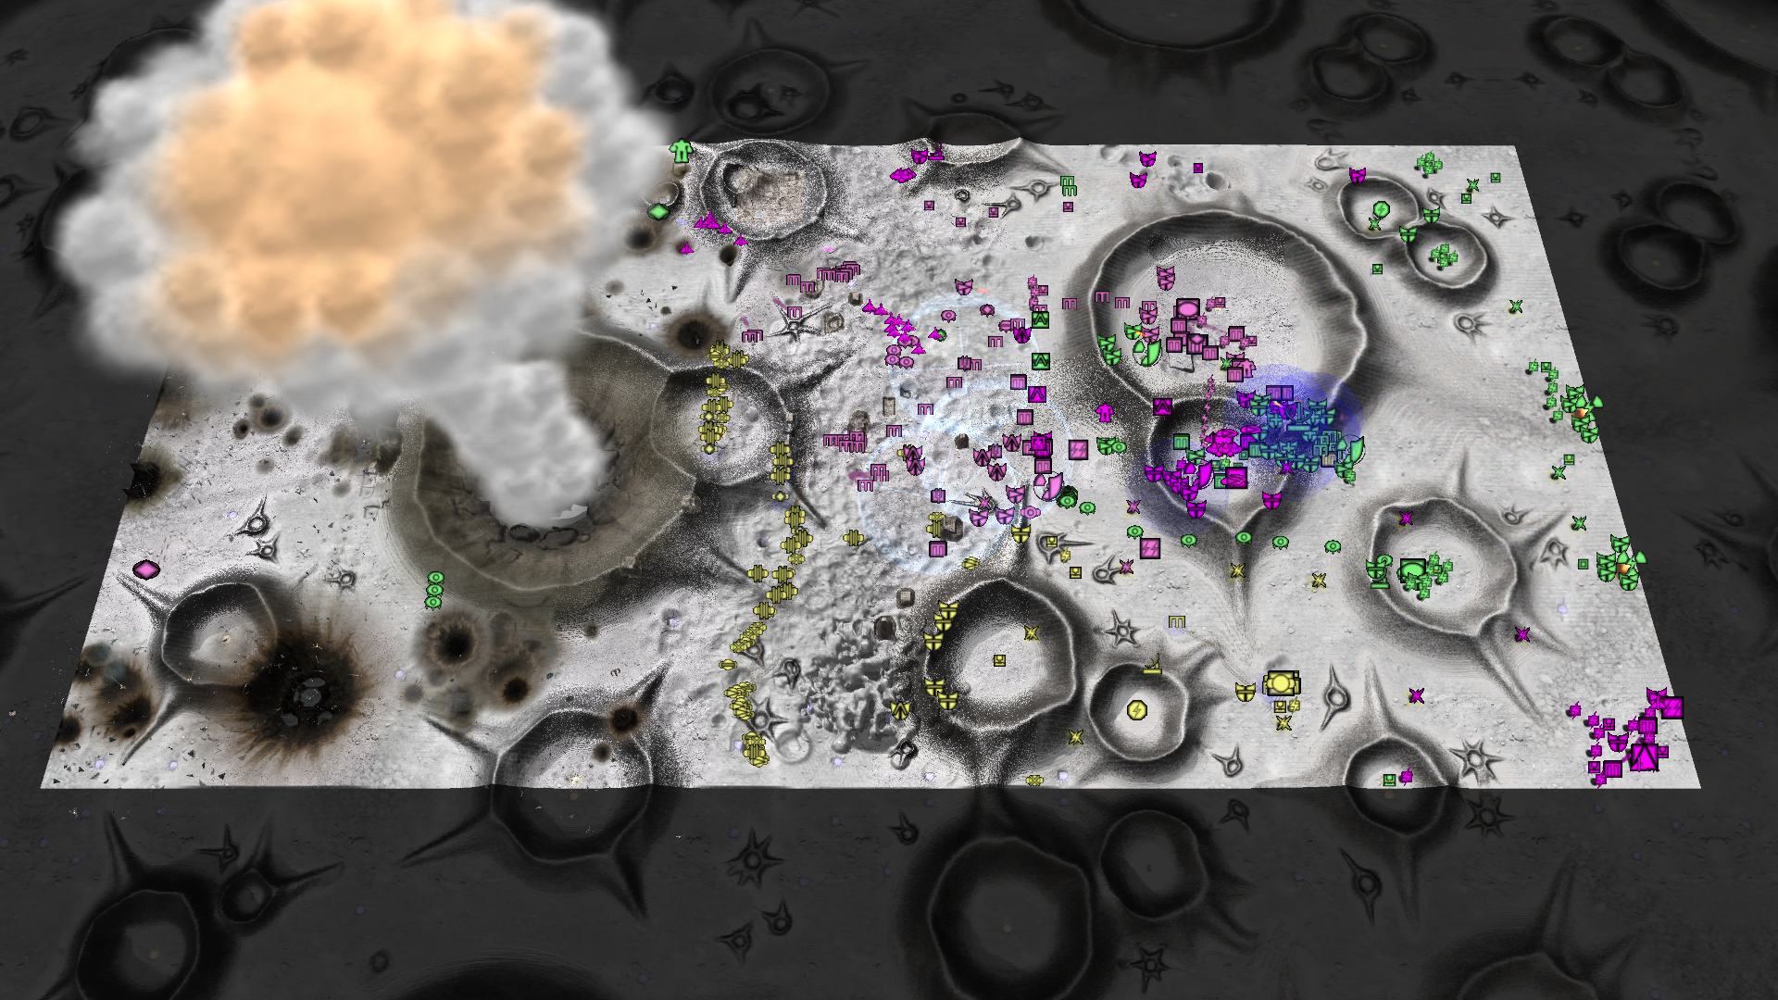
Notes:
Some of these craters are moon craters, but others are caused by massive explosions.
‹#›

Slide 14
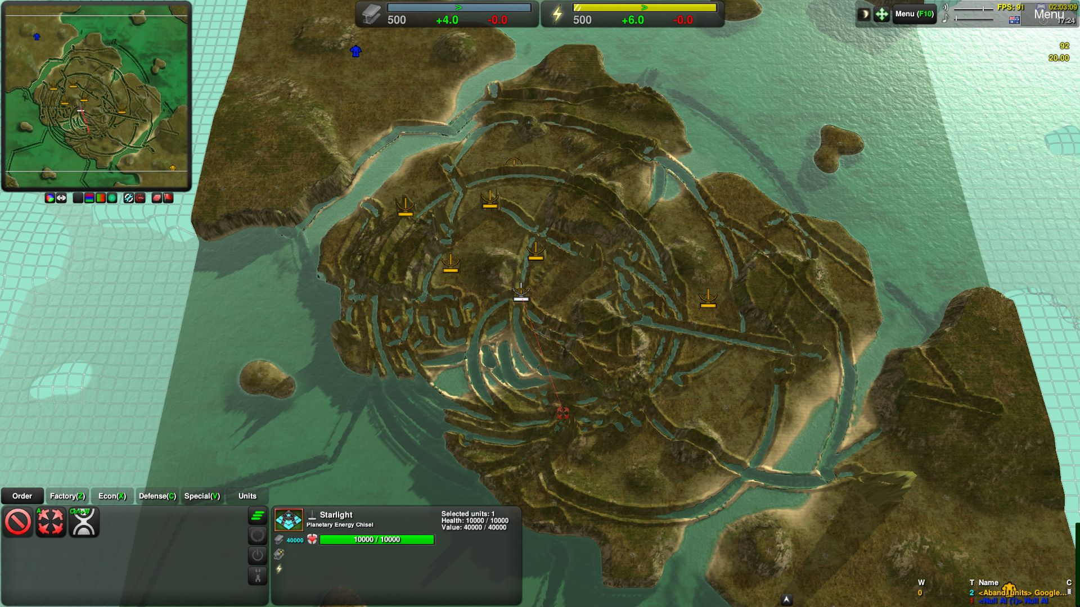
Notes:
Weapons can affect the map too. An orbital laser can do this to an island.
.
‹#›

Slide 15
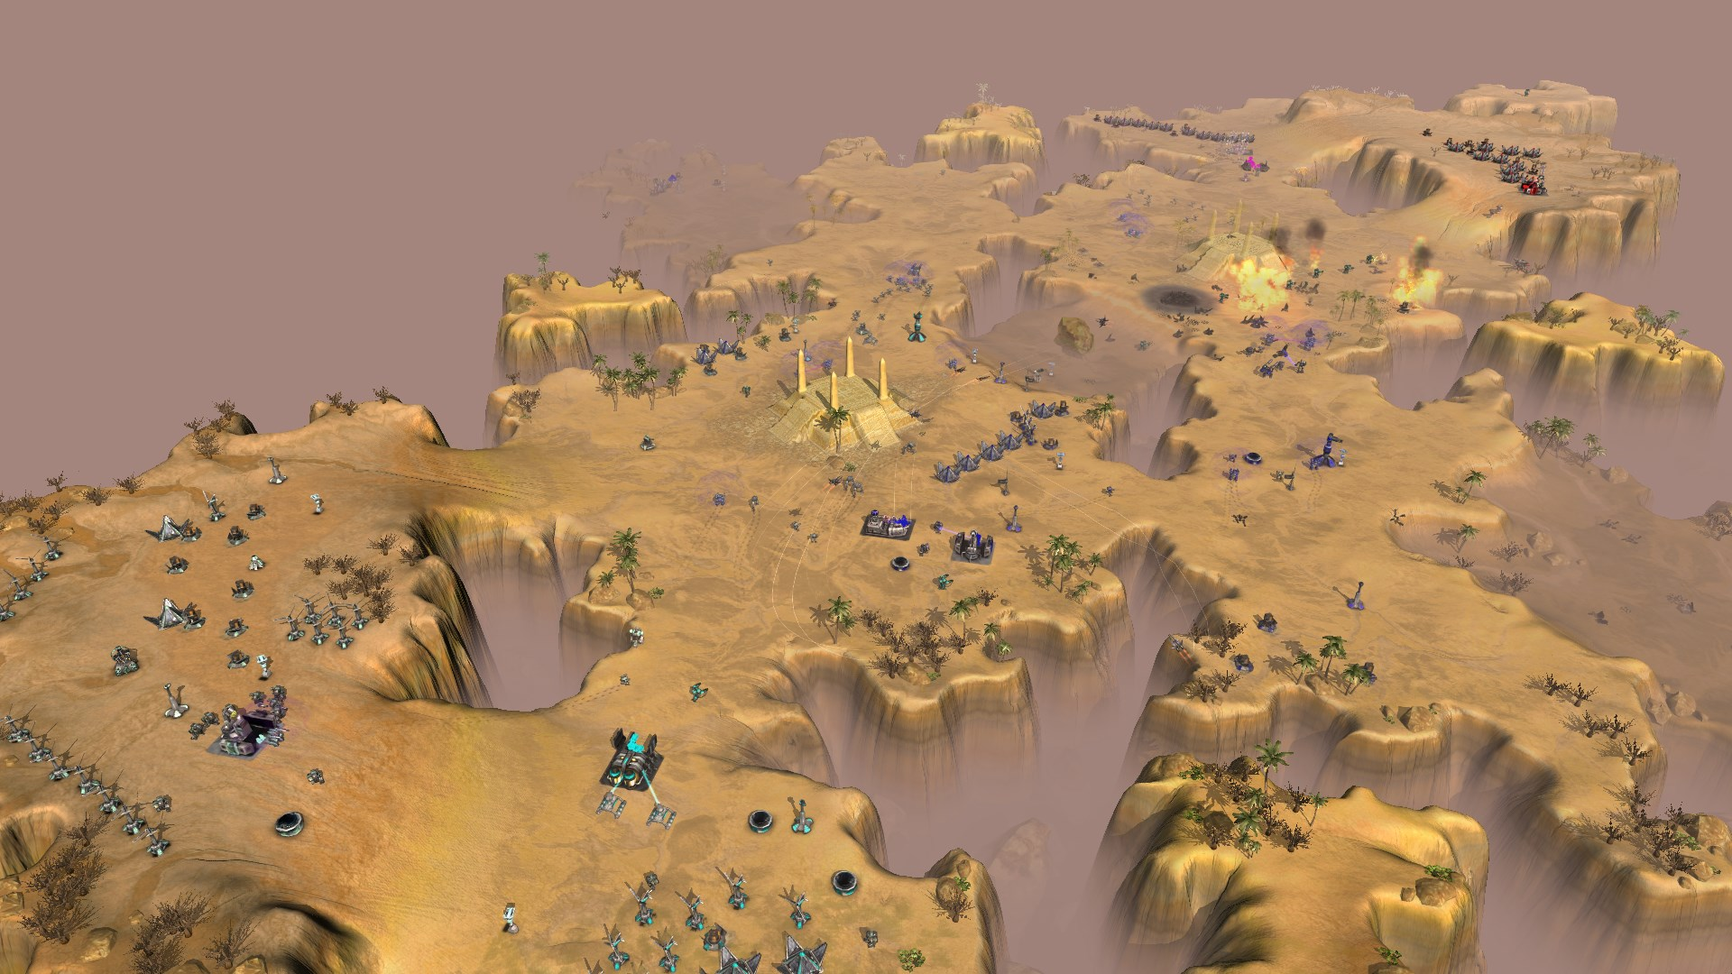
Notes:
Zero-K is a real time strategy game where 2 to 32 players fight each other. The focus is on constant action.
‹#›

Slide 16
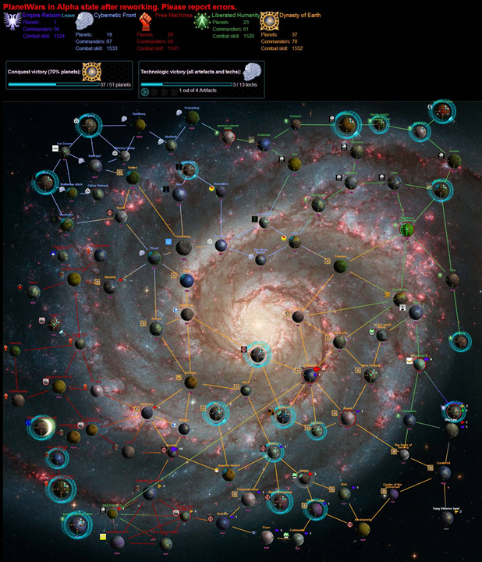

Slide 17
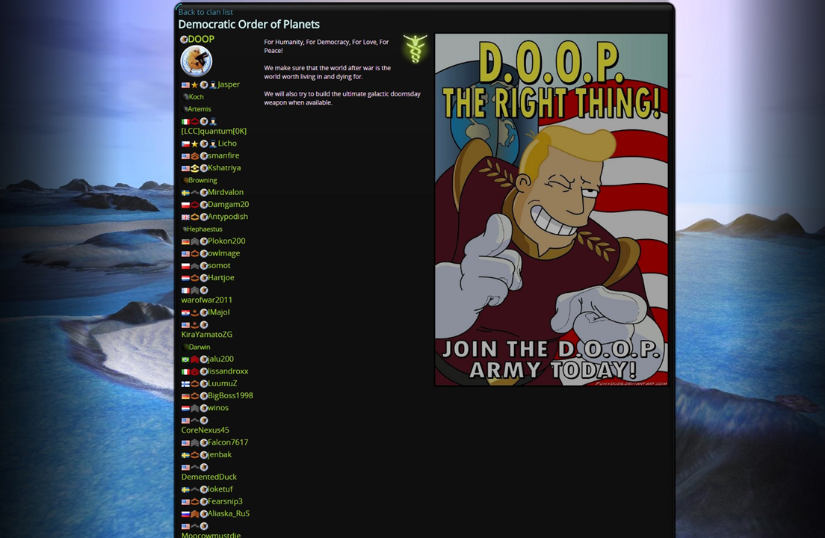

Slide 18
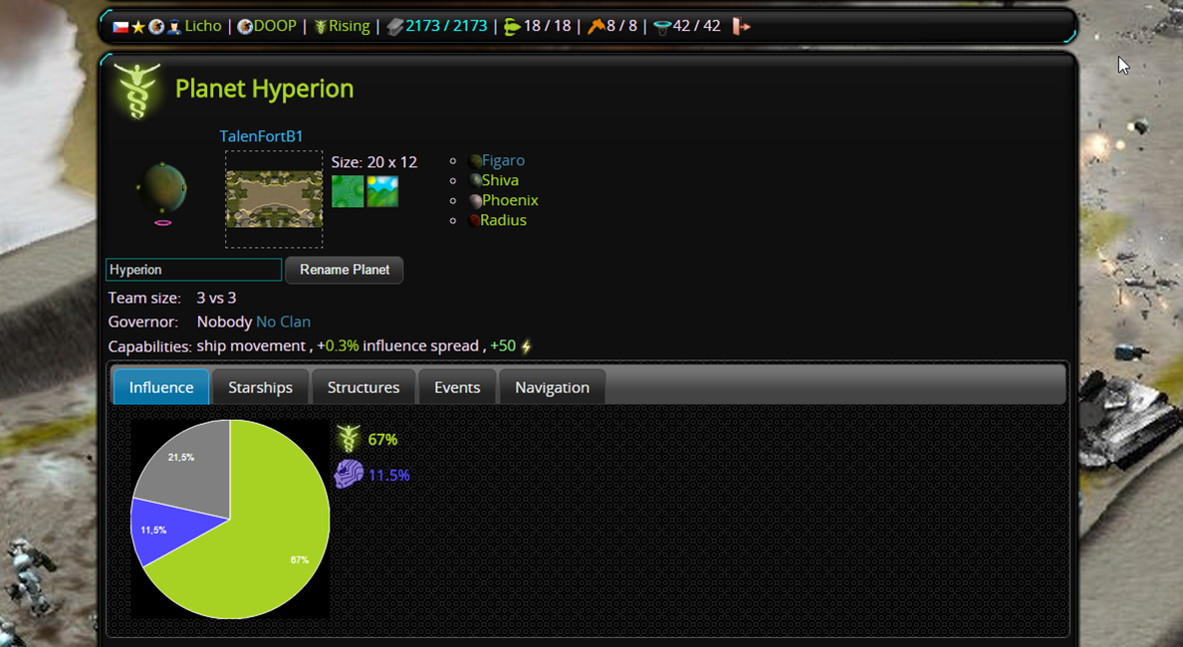

Slide 19
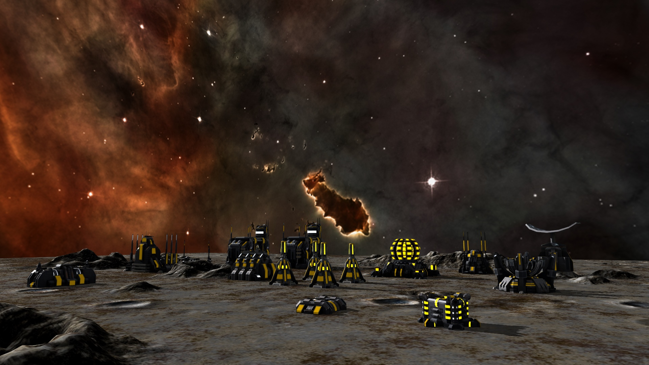

Slide 20
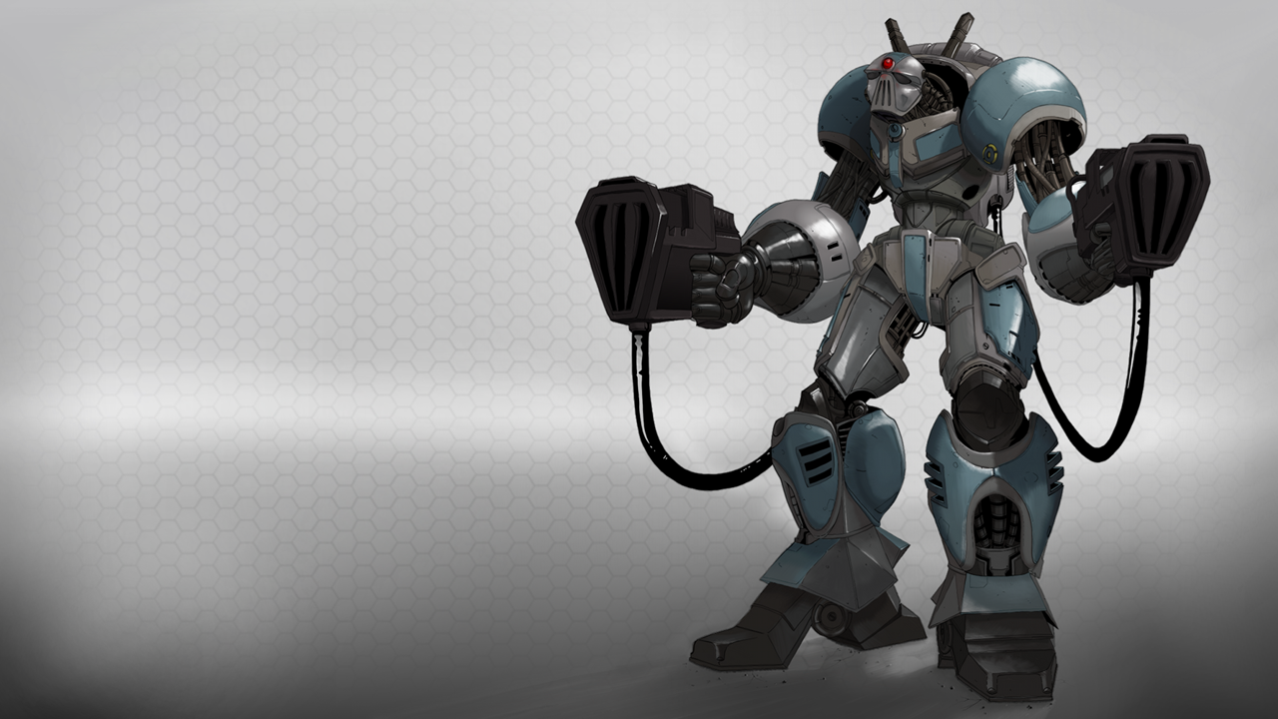
76,502 accounts
24,307 players who played online
420,050 battles
25 minutes per game

Slide 21

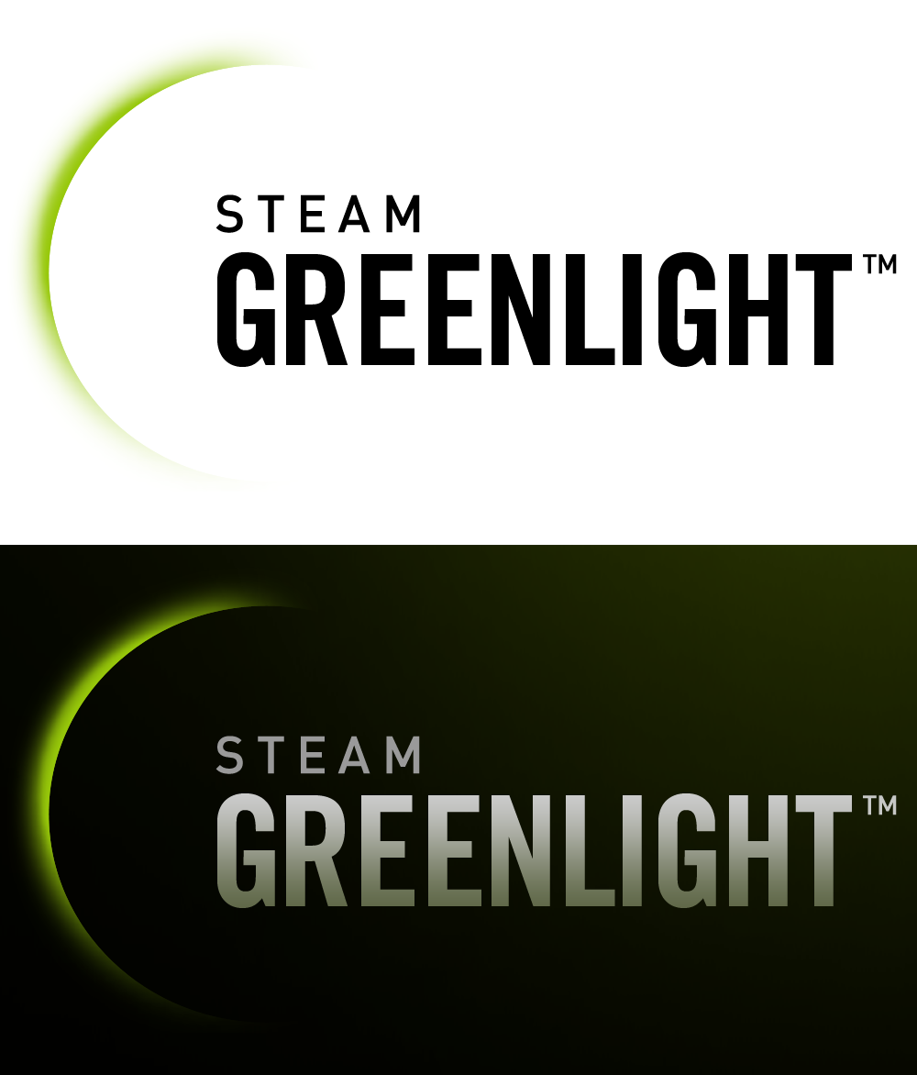
Vaarsuvius The Wizard 5 Aug, 2015 @ 7:52am
Oh boy. I played this game. And it is... So beautiful.
Especially when we holed up in the land bridge sepating the 2 islands on the map, and proceeded to fortify the heck out of it. I mean it. Shields, Guns, Terraforming. You name it, we got it.
Please Gaben! RELEASE THIS MASTERPIECE!
Killcreek2 17 Apr, 2014 @ 2:07pm
Ohhh, yes yes YES! Finally a True successor to TA! ~ SupCom was ok, but it was missing that certain something that made TA one of the greatest RTS games *of all time*, so heres hoping this game nails it.
I'm getting over-excited, must calm down ...
Szyba 21 Apr, 2014 @ 11:03am
This game is awesome indeed. Less focused on economy, more on combat. Also its f2p, no micropayments :3
okster 26 Apr, 2014 @ 9:37am
i have heard so much about this game, and now its on greenlight? count me in!
Given how awesome this game is, I'm surprised there aren't more people playing it. Hopefully getting this game on Steam will expose it to a wider audience...
I want a long-term relationship with this game.
Edomaden 18 Apr, 2014 @ 5:51pm
pretty cool looking, a call back to the golden age of RTS? I'm down.

Slide 22
Vaarsuvius The Wizard 5 Aug, 2015 @ 7:52am
Oh boy. I played this game. And it is... So beautiful.
Especially when we holed up in the land bridge sepating the 2 islands on the map, and proceeded to fortify the heck out of it. I mean it. Shields, Guns, Terraforming. You name it, we got it.
Please Gaben! RELEASE THIS MASTERPIECE!
Killcreek2 17 Apr, 2014 @ 2:07pm
Ohhh, yes yes YES! Finally a True successor to TA! ~ SupCom was ok, but it was missing that certain something that made TA one of the greatest RTS games *of all time*, so heres hoping this game nails it.
I'm getting over-excited, must calm down ...
Szyba 21 Apr, 2014 @ 11:03am
This game is awesome indeed. Less focused on economy, more on combat. Also its f2p, no micropayments :3
okster 26 Apr, 2014 @ 9:37am
i have heard so much about this game, and now its on greenlight? count me in!
Given how awesome this game is, I'm surprised there aren't more people playing it. Hopefully getting this game on Steam will expose it to a wider audience...
I want a long-term relationship with this game.
Edomaden 18 Apr, 2014 @ 5:51pm
pretty cool looking, a call back to the golden age of RTS? I'm down.

